Slide 1
Defence Technology & Laws
Transfer of Technology
Agreements
V.Sreedhara Reddy
Advocate

Slide 2

Law and Technology
Definition of LAW
A body of rules of conduct of binding legal force and effect, prescribed, recognized, and enforced by controlling authority
Definition of TECHNOLOGY
collection of techniques, skills, methods, and processes used in the production of goods or services or in the accomplishment of objectives, such as scientific investigation

Slide 3

A distinctive character of 21 century.
Role in governance, administration, management, security & defence, education, trade & commerce, science & medicine, research & development.
Digital Technology – to accelerate economic development.
TECHNOLOGY
Interest of societal development
Against societal ethics and morality

Slide 4


Defence Technology
It is the application or usage of technology in warfare: developed by scientists and specialists specifically for military purposes.
A rapid change in 19th century

Slide 5

Importance of Defence Technology
Investment in Defence Technology enables the State to combat & overcome threats from antinational elements.
Helps minimise human casualities
Helps in countering terrorist threats/infiltrations
Defence Technology:
  Use of Drone Technology in Military Operations
  Digital/Smart fencing
  Pilotless aircrafts
  Autonomous Vehicles

Slide 6
Technology Diffusion (TD)
Meaning:- It is a theory that seeks to understand reasons, methods and the rate at which technologies/innovations are spread in a social system.
Origin:- It originated in the first half of the 20th century and was later popularized by American sociologist ‘Everett M. Rogers’ in his book ‘Diffusion of Innovations’, published in 1962.
Major Channels of TD:- International trade and Foreign direct investment(FDI).

Slide 7
Scope of TD:- Technology diffusion in defence has expanded the scope of the battlefield – from traditional ‘front-line’ battle to technology capabilities that allow military forces to know the nook and corner of enemy territory.
Demerits of TD:- It made additional parties vulnerable to such weapons, especially in the light of development of ‘weapons of mass destruction’.
Way Forward:- An agreement for harmonious conduct of international affairs for peace and stability will instigate broader distribution of technologies.

Slide 8
Internet of Things (IOT)
ITU Definition:
“IOT is global infrastructure for the information society, enabling advanced services by interconnecting (physical and virtual) things based on existing and evolving interoperable information and communication technologies”
Said to be next stage of Information revolution.
Network of physical objects or "things" embedded with electronics, software, sensors, and connectivity to enable objects to exchange data with the manufacturer, operator and/or other connected devices.
Security remains the biggest concern in adopting IOT Technology.
cyber attacks are likely to become increasingly physical (rather than simply virtual) threat.
Notes:
Gartner Research there will be nearly 26 billion devices on the Internet of Things by 2020

Slide 9
Artificial Intelligence
AI has ability to rationalize and take actions that have the best chance of achieving a specific goal
becoming a critical part of modern warfare
capable of handling larger volumes of data more efficiently
AI improves self-control, self-regulation, and self-actuation of combat systems due to its inherent computing and decision-making capabilities

Slide 10
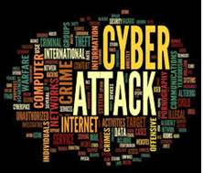
Cyber Security
“cyber weapons the most dangerous innovation of this century”. Eugene Kaspersky, CEO, Kaspersky Lab.
“I dream of a digital India where cyber security become an integral part of our National security” …………. Narendra Modi, PM, India
Cyber security is “one of the most serious economic and national security challenges we face as a nation.” Barack Obama, Former President of USA.
“No national security without Cyber Security” – Chinese’s President Xi Jinping

Slide 11
Definition of Cyber Security
ITU defines Cyber Security as:
“Cyber security is the collection of tools, policies, security concepts, security safeguards, guidelines, risk management approaches, actions, training, best practices, assurance and technologies that can be used to protect the cyber environment and organization and user’s assets”.
Cyber Security defined under Sec 2(1) (nb) of IT Act, 2000.
“Protecting information, equipment, devices, computer, computer resources, communication device and information stored therein from unauthorised access, use, disclosure, disruption, modification or destruction.”

Slide 12
Types of Cyber Crimes
What is Cyber crime?
Cyber Crime is not defined in Information Technology Act 2000 nor in any other legislation in India.
Important Types of Cyber Crimes
  Hacking
  Spamming
  Injecting Malware
  DOS/DDOS
None of these are defined under IT Act,2000

Slide 13

Cyber Criminals & their Motives
Cyber Terrorism - with an intention to cause business disruption or to disrupt the country’s economy.
Cyber Espionage/ industrial espionage, Inter corporate rivalry
To steal customer data to make financial gain.

Slide 14
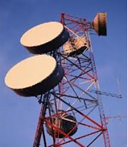
Imported Telecom Equipment
Some Concerns
Telecom networks are vulnerable to malicious attacks and could expose critical Telecom infrastructure to failure, cyber espionage or cyber attacks.
US Congressional Committee concluded in 2012 that Telecom equipment vendors Huawei and ZTE pose a security threat to US.
Spyware & Malwares feared embedded into the equipment or the software loaded into the equipment.
The Committee believes that Chinese Govt. may resort to Industrial espionage if telecom equipment from China are used.

Slide 15
Global cybersecurity Index (GCI)
GCI is to drive the issue of cybersecurity to the forefront of national agendas.
GCI ranks the level of commitment in five areas of GCA.
Global ranking of cybersecurity readiness.
Promote government strategies at a national level
Drive implementation efforts across industries and sectors
Integrate security into the core of technological progress
Foster a global culture of cybersecurity
Cyber Security in Defence Sector​

Slide 16
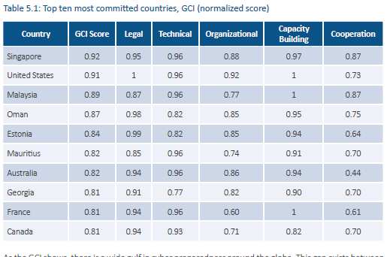

Slide 17
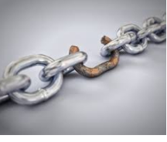
Defence Industrial Establishments
Today’s industrial control systems (ICS) face an array of digital threats.
Cyber attacks on industrial systems can have severe consequences.
Impact extends from data to industrial infrastructures and potentially people’s safety.
Connected objects within these systems, from sensors to connected vehicles, can be targeted by cyber criminals.
Real and urgent problem that must be addressed to stay competitive in the digital age.

Slide 18
Historical Perspective
1775 - Establishment of Board of Ordnance factory in Fort William, Kolkata
1884- Garden Reach Shipbuilders and Engineers Limited (GRSE), Kolkata
1934 – Mazagon Dock Shipbuilders Ltd., Mumbai
1941- Hindustan Shipyard Limited (HSL), Visakhapatnam
1957- Goa Shipyard Limited (GSL)

Slide 19
Historical Perspective
1958 – Establishment of DRDO
1964 – BEML
1970- Establishment of BDL
1973 - Mishra Dhatu Nigam Limited (MIDHANI)
1960s – Collaborative Military production
2001- Defence Sector was opened for private Sector
2003 – Defence Procurement Procedure (DPP)
2008 – Defence offsets were introduced in DPP

Slide 20
Historical Perspective
2012 – Defence Offset Guidelines listed six different avenues out of which three pertain to ToT in some form.
2014 – ‘Make in India’ campaign -Defence manufacturing was given top priority.
2015 – USA has offered ToT of 17 technologies related to Defence to India.

Slide 21
ToT
What is Transfer of Technology?
Various Stakeholders in TOT :
  Transferor & Transferee
  Licensor & Licensee
National Goals
  Self Sufficiency Vs Self Reliance
  Self-reliance in production of competitive Defence technologies
  Thrust on developing superior military strength

Slide 22
KNOW-HOWS AND KNOW-WHYS
Know-Hows
It involves practical knowledge on how to accomplish something.
It doesn’t include knowledge required to carry out major modifications, or upgrades of the products.
Know-Whys
It includes iterative experiments using extremely expensive laboratory instruments to arrive at a conclusion as to ‘why’ a particular combination of composition, process and shape is optimal.
It is not provided as it provides opportunity to compete with the original firm.

Slide 23
Modes of ToT
Modes of Technology transfer :
  Foreign Direct Investment
  Licensing Technology
  Joint Venture & Strategic Alliances
  Reverse engineering

Slide 24
TYPES OF TOT
Types of ToT
Licensed Production Agreements
Coproduction Agreements
Joint Venture Agreements
Foreign Design Assistance

Slide 25
Mode of ToT
1 | Limited Period | Non Exclusive | Without IP Rights
2 | Limited Period | Exclusive | Without IP Rights
3 | Region/Country Specific | Exclusive | Without IP Rights
4 | Outright sale | NA | With IP Rights
5 | Any other Mode suitable to the Situation
Notes:
Non exclusive license may may kep away potential

Slide 26
ToT Procedure
Expression of Interest from Industries seeking ToT
Technical Assessment of Industries seeking ToT
Due-Diligence of Technologies by Industries
Technology evaluation
Approval of recommendations of Cost Estimation Committee
Signing of Licensing Agreement
Handing over of ToT documents to the Industry
Providing Hand holding Support
Issue of ToT Certificate
Renewal /Extension of License

Slide 27
Licensing Agreement ToT
Why LAToT?
Parties in LAToT
Important Clauses:
  Preamble
  Technical Know-how
  Licensing Regions
  Grant of License: Exclusive/Non Exclusive
  Period of License
  Responsibilities of Parties
  Technology Transfer Documents
  Right to Inspect
  Indemnity
  Production, Sale & Marketing
  ToT Fee/
  Royalty
  Marking
  Security of Technology
  Title & Ownership of Designs
  Termination & Effect of Termination
  Dispute Resolution

Slide 28
TOT : Licensor & Licensee’s Benefits
Licensor’s/Seller’s
  Primary Benefit: Potential Revenue can be gained
  freedom to determine pricing and the license terms
  recover R&D costs
Licensee’s/Buyer’s
  Technology Acquisition
  Modernization of Production System
  Industrial growth & development
  Increase in local Employment &
  Tax Revenues
Modernization of Production System

Slide 29
Joint ventures (JVs)
What is Joint Venture?
FDI route is used by Governments to facilitate ToT into JVs with domestic firms.
  Brahmos Aerospace : India – Russia JV for developing and producing the Brahmos missiles.
  MRSAM : Indo-Israel JV
JVs will give boost to domestic MSMEs by way of sub-contracts from JVs.
This arrangement leads to joint intellectual property rights (IPRs) as well as shared international market space.

Slide 30
Examples of Some JVs
Indian Partner in JV | Foreign Partner in JV | Name of JV | Area
HAL | United Aircraft Corporation-Transport Aircraft & Rosoboronexport Russia | Multi-role Transport Aircraft Ltd. (MTAL)(2010) | Multi role Transport Aircraft
Reliance Group | Dassault Aviation | Dassault Reliance Aerospace Limited (DRAL)(2017) | Components of Aircraft
Bharat Electronics Limited (BEL), | Thales | BEL Thales Systems Limited (2013) | Air surveillance, including Air Traffic Management radars, and select ground-based military radars.
Tata (Tata Advanced Systems) | Boeing Aerospace | Tata Boeing Aerospace Ltd. (TBAL)(2018) | Fuselages for AH-64 Apache Helicopter.

Slide 31
Important Clauses in JV Agreements
Object(s) of the JV
Name & Principal Place
Capital & Share of Profits/Losses
Confidentiality/Non Disclosure Agmt
Termination Clause
Indemnity
Dispute Resolution Clause/Arbitration
Importance of Witness
Notes:
London Court of International Arbitration, Singapore International Arbitration Centre, FICCI Arbitration & Conciliation Tribunal

Slide 32
TOT - IMPORTANT AGREEMENTS
  General overview of Agreements
  (CNDA)
  Material Transfer Agreement (MTA)
  Licensing Agreement for Transfer of Technology (LAToT)

Slide 33
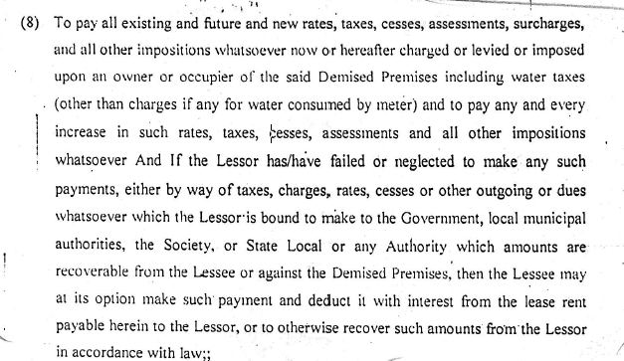
Tax Clause from Lease deed

Slide 34
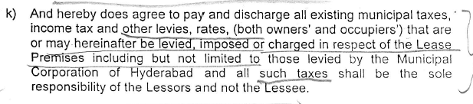
Clause from Commercial Lease deed

Slide 35
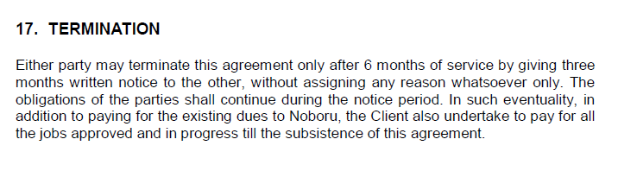
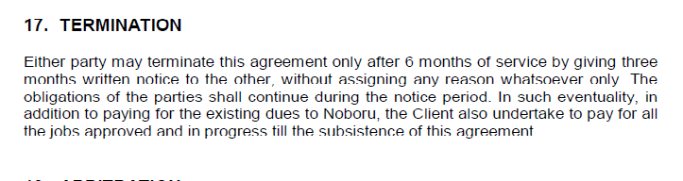
Termination clause from a Digital marketing Agmt

Slide 36
Confidentiality & NDA
Why CNDA?
Types of NDA
Parties in CNDA
Important Clauses:
  Preamble
  Defining Confidential Information
  Restrictions on disclosure
  Ownership & IPR
  Term
  Indemnity
  Return of Confidential Information
  Termination & Effect of Termination
  Dispute Resolution

Slide 37
Material Transfer Agmt.
Why MTA? (Testing & Validation of Products)
Parties in MTA
Important Clauses
  Material Testing & Validation
  Restrictions on usage
  Control of material
  No warranty
  Confidentiality
  Exceptions to confidentiality
  Reports
  Term & Termination & Effects of Termination
  Indemnity
  Dispute Resolution

Slide 38
IP Assignments & Licences
What is Intellectual Property?
IP assignment is a permanent transfer of ownership of an IP from one party (the assignor) to another party (the assignee).
A licence agreement, is a contract under which the holder of the IP (licensor) grants permission to another party (licensee) for the use of its IP, within the limits set by the provisions of the contract.

Slide 39
ToT - Issues & Challenges
Key Issues
  Technology Acquisition
  Choice of Technology
  Terms of Technology Transfer
  Creating local capability
Barriers for ToT

Slide 40
                Thanks

